Slide 1

E GOVERNANCE IN YOUR SMART VILLAGE
PRESENTED BY
M N V VISWANADH
138W1D5917
VRSEC, MTECH

Slide 2
CONTENTS
VILLAGE PROBLEMS OR STATUS
AUTHORITIES INFORMATION
ADMINISTRATION SERVICES
OTHER SERVICES

Slide 3
COMPLAINT OR STATUS
FOOD & HEALTH
DEFENCE AND SECURITY
EDUCATION & EMPLOYMENT
AGRICULTURE
MUNICIPL ISSUES

Slide 4
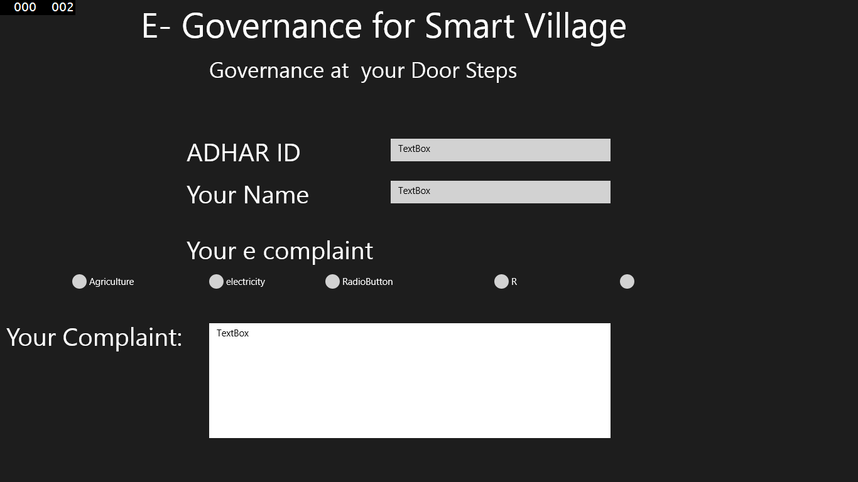
SCREEN SHOT

